Slide 1



Livspace: Transforming Home Design & Renovation
Livspace is a leading home design and renovation platform in India, offering a seamless and personalized experience to homeowners. They aim to revolutionize the home improvement process by providing end-to-end solutions, from design to execution.
by Vignesh Gowda

Slide 2

Livspace and the Six Force Model
Explore Livspace's competitive landscape through the Six Force Model analysis. Gain insights into the forces shaping Livspace's industry and strategy, including suppliers, buyers, substitutes, new entrants, industry competitors, and complementors.

Slide 3
Company Background and History
Founding
Growth and Expansion
Mission and Values
Livspace was founded in 2015 by Anuj Srivastava and Ramakant Sharma, with a vision to simplify and modernize the home renovation experience.
Since then, Livspace has expanded its operations to multiple cities across India and has become a major player in the home design and renovation market.
Their mission is to empower homeowners with the tools and resources to create dream homes, fostering a customer-centric approach and a commitment to innovation.

Slide 4

Livspace's Value Proposition and Target Market
1
Convenience and Transparency
2
Personalized Design Solutions
Livspace offers a user-friendly online platform and a dedicated team of designers and contractors, providing a streamlined and transparent experience.
Livspace caters to diverse customer needs and preferences, offering a wide range of design styles and materials, from modern minimalist to traditional Indian aesthetics.
3
Quality and Reliability
4
End-to-End Solutions
Livspace ensures high-quality materials and craftsmanship, backed by its robust quality control processes and experienced team.
Livspace provides a complete home renovation package, encompassing design, planning, materials sourcing, and execution.

Slide 5

Livspace's Product and Service Offerings
Design & Planning
Material Sourcing
Livspace offers a comprehensive range of design services, from initial consultations to 3D visualization and detailed plans.
Livspace partners with leading manufacturers and suppliers, offering a wide selection of high-quality materials for every aspect of the home.
Construction & Execution
Project Management
Livspace manages all aspects of construction, from demolition and rebuilding to finishing touches, with a dedicated team of skilled contractors.
Livspace provides regular updates and progress reports, ensuring timely completion and seamless communication throughout the project lifecycle.

Slide 6
Livspace's Customer Journey and Experience
Initial Consultation
1
Customers share their vision and requirements with Livspace's designers, providing insights into their preferences, budget, and timeline.
2
Design & Planning
Livspace's team creates customized 3D design plans, incorporating the customer's feedback and suggestions.
Material Selection
3
Customers explore a wide range of high-quality materials and finishes, selecting the best options based on their style and budget.
4
Construction & Execution
Livspace's experienced contractors manage the construction process, ensuring quality craftsmanship and adherence to the design plans.
Project Completion & Handover
5
Livspace completes the project on time and within budget, providing a walkthrough and final inspection.
orientation=vertical

Slide 7



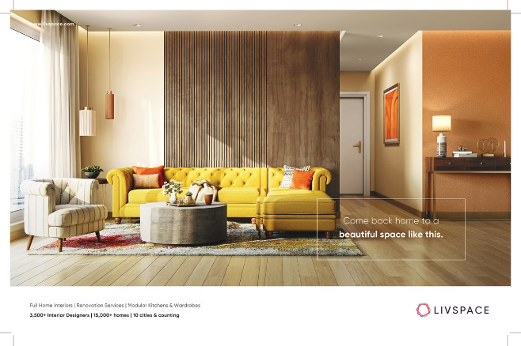


Livspace's Marketing and Branding Strategy
Digital Marketing
Influencer Marketing
Livspace leverages online platforms like social media, search engine optimization, and paid advertising to reach its target audience.
Livspace collaborates with home design and lifestyle influencers to showcase its products and services to a wider audience.
Experiential Marketing
Customer Testimonials
Livspace participates in home design exhibitions and events to engage with potential customers and showcase its expertise.
Livspace features customer testimonials and positive reviews on its website and social media channels, building trust and credibility.

Slide 8





Livspace's Technology and Innovation
3D Visualization
AI-Powered Design
Online Project Management
Smart Home Integration
Livspace utilizes cutting-edge 3D visualization technology to create immersive and realistic renderings of home designs.
Livspace is integrating artificial intelligence to personalize design suggestions and offer customized solutions.
Livspace's online platform provides real-time project tracking, communication tools, and progress reports for customers.
Livspace is exploring integration with smart home devices and systems, enhancing the functionality and efficiency of homes.
orientation=vertical

Slide 9


Livspace's Growth and Expansion Strategy
Expansion to New Cities
Livspace continues to expand its operations to new cities across India, targeting areas with growing demand for home renovation services.
Diversification of Service Offerings
Livspace is expanding its product and service portfolio to include new categories, such as furniture, décor, and smart home solutions.
Partnerships and Collaborations
Livspace is forging strategic partnerships with real estate developers, interior design firms, and other industry players to reach a wider audience.

Slide 10
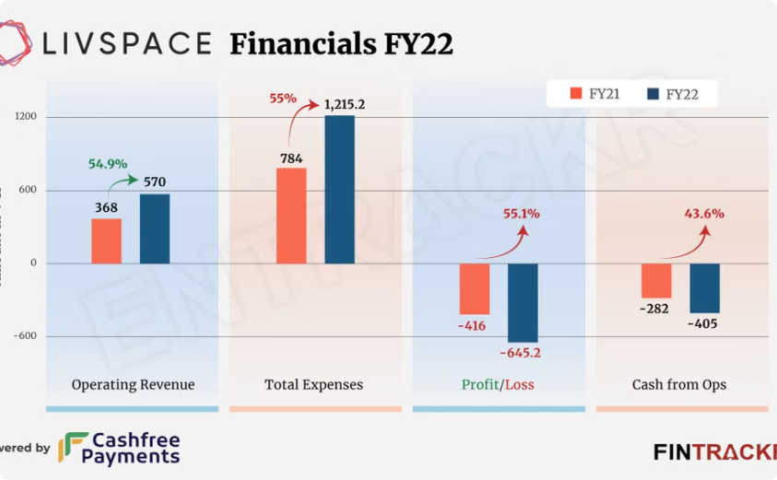

Livspace's Financial Performance and Business Model
Revenue Growth
Funding Rounds
Livspace has experienced significant revenue growth in recent years, fueled by the increasing demand for home renovation services in India.
Livspace has raised substantial funding from leading venture capitalists, demonstrating the company's strong growth potential and market appeal.

Slide 11

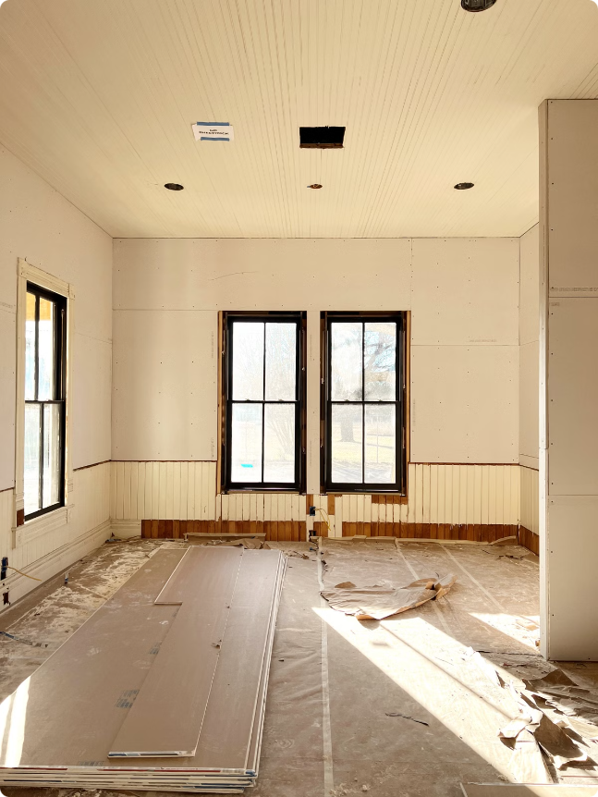
Lessons Learned and Key Takeaways
1
Customer Centricity
2
Technology and Innovation
Livspace prioritizes customer satisfaction, providing a personalized and seamless experience throughout the renovation journey.
Livspace leverages technology to enhance its services, improve efficiency, and provide a competitive edge in the market.
3
Scalability and Expansion
Livspace has demonstrated its ability to scale its operations and expand into new markets, capturing a larger share of the home renovation sector.

Slide 12

Thank You for Joining Us
As we conclude our presentation, we express our sincere gratitude for your time and interest in Livspace. Your support fuels our commitment to transforming home design and renovation experiences.

